Slide 1


CMR ENGINEERING COLLEGE (UGC AUTONOMOUS) (ACCREDITED BY NAAC AND NBA , APPROVED BY AICTE NEW DELHI, AFFILIATED TO JNTU HYDERABAD) KANDLAKOYA, MEDCHAL ROAD, HYDERABAD-501 401.
Department of Cyber Security
A Major Project
On
“Automated Detection of Deep Fakes : A Deep
Learning Approach.”
S.ANUPRIYA : (218R1A6253)
T.ARAVIND : (218R1A6258)
G.ROHITH REDDY : (218R1A6226)
CH.MANOJ SAI KUMAR : (218R1A6218)
Under the Guidance of,
Mrs. M . Amrutha,
Assistant Professor,
Dept. of CS.
A.Y 2024-2025

Slide 2
TABLE OF CONTENTS
Abstract
Introduction
Existing System
Disadvantages
Proposed System
Advantages
Requirements
Literature Survey
System Design
a) Architecture
b) UML diagrams
Sample code
Output

Slide 3
ABSTRACT
This comprehensive study delves into the dynamic landscape of deep learning applications, focusing on the burgeoning realm of deep fakes. Deep learning has seamlessly integrated into fields like natural language processing, machine learning, and computer vision, giving rise to innovative applications. However, the surge in deep fakes, sophisticatedly manipulated videos/images, has become a pressing concern. The nefarious applications of this technology, such as fake news, celebrity impersonations, financial scams, and revenge porn, pose significant threats in the digital realm. Particularly, public figures like celebrities and politicians are highly susceptible to the Deep fake detection challenge. This research systematically assesses both the production and detection aspects of deep fakes, employing diverse deep learning algorithms, including InceptionResnetV2, VGG19, CNN, and Xception. The evaluation, conducted on a Kaggle deep fake dataset, highlights Xception as the most accurate among the algorithms studied. As malicious uses of deep fakes escalate, the imperative for robust detection mechanisms intensifies to safeguard against potential societal consequences.

Slide 4
INTRODUCTION
In the realm of technological evolution, the human face stands as the quintessential identifier, a uniquely personal aspect that defines individuals. However, the relentless progress of face synthesis technologies has ushered in an era where the sanctity of facial identity is under siege. The escalating threat of unauthorized face alterations looms large, prominently exemplified by the advent of deep fake technology. This artificial intelligence marvel facilitates the seamless superimposition of one person's face onto another's, all executed without the subject's consent. As a consequence, the profound implications of deep fakes extend far beyond the realm of mere privacy invasion, posing a significant challenge to the integrity of personal and public security.
At the forefront of combating this emerging menace is the application of deep learning—a formidable and versatile technology that has left an indelible mark across various domains, including machine learning, computer vision, and natural language processing. With its ability to discern intricate patterns and nuances, deep learning has emerged as a potent tool in the ongoing battle against deep fake proliferation. This transformative technology holds the promise of fortifying our defenses against malicious face alterations, exemplifying the innovative synergy between artificial intelligence and the safeguarding of our fundamental right to identity and security.

Slide 5
EXISTING SYSTEM
The existing system focuses on the analysis and utilization of previously deployed deep fake detection algorithms. It extensively explores classic detection methods and contemporary deep learning-based approaches, including Convolutional Neural Networks (CNN), Recurrent Neural Networks (RNN), and Long Short-Term Memory (LSTM). Classic methods often rely on rule-based heuristics, while deep learning methods harness the hierarchical learning capabilities of neural networks to discern intricate patterns indicative of deep fakes. The study aims to provide a comprehensive understanding of the strengths and limitations of these methods in identifying manipulated content. In contrast, the proposed system takes a proactive stance by integrating cutting-edge deep learning algorithms. The proposed system aims to enhance detection accuracy, contributing to a deeper comprehension of deep fake production and distribution for more effective countermeasures.

Slide 6
DISADVANTAGES:
The existing system relies on traditional and contemporary methods, potentially limiting adaptability to emerging deep fake techniques.
Classic methods' reliance on rule-based heuristics may struggle with the evolving sophistication of deep fake creation, leading to decreased accuracy.
While deep learning methods are employed, the existing system may lack a comprehensive understanding of the intricate patterns characterizing evolving deep fake technologies.
Depending on data complexities, the existing system may exhibit variable accuracy, potentially rendering it less reliable across diverse scenarios.

Slide 7
PROPOSED SYSTEM:
The proposed system aims to combat the escalating threat of deep fakes through an integrated approach leveraging cutting-edge deep learning algorithms. Utilizing a Kaggle deep fake dataset, our system employs InceptionResnetV2, VGG19, CNN, and Xception algorithms for comprehensive evaluation. The emphasis is on developing a robust detection mechanism to discern authentic content from manipulated ones. By scrutinizing the intricacies of deep fakes, the system aspires to contribute to a deeper understanding of their production and distribution. The integration of multiple algorithms ensures a nuanced analysis, while the dataset provides a diverse range of scenarios for effective training and testing. This holistic approach seeks to enhance the overall accuracy and reliability of deep fake detection, mitigating the potential societal consequences of fake news, impersonations, and privacy violations. The proposed system stands as a pivotal step toward fortifying our digital landscape against the malevolent misuse of deep fake technology.

Slide 8
ADVANTAGES
proposed system integrates advanced algorithms like InceptionResnetV2 and Xception, enhancing its capability to detect sophisticated deep fake manipulations effectively.
Utilizing multiple algorithms facilitates a nuanced analysis, ensuring a robust detection mechanism capable of discerning authentic content from manipulated instances.
The system benefits from a Kaggle deep fake dataset, providing a diverse range of scenarios for training and testing, enhancing its adaptability to real-world situations.

Slide 9
HARDWARE REQUIREMENTS: 1)Operating system :Windows 2)Processor : i5 and above 3)Ram : 8gb and above 4)Hard Disk : 25GB in local drive
SOFTWARE REQUIREMENTS:
Software : Anaconda
Primary Language : Python
Frontend Framework : Flask
Back-end Framework : Jupiter Notebook
Database : Sqlite3
Front-End Technologies : HTML,CSS,JavaScript and Bootstrap4

Slide 10
LITERATURE SURVEY
Title | Journal/confer ence published | Author(s) | Year publis hed | Abstract | Method &Technolog ies | Summary
WildDeepfake: A Challenging Real-World Dataset for Deepfake Detection | arXiv | M. Mirza and S. Osindero, | 2022 | Introduces WildDeepfake, a dataset with 7,314 face sequences from 707 deepfake videos sourced from the internet, aiming to support detection of real-world deepfakes. | Attention-based Deepfake Detection Networks (ADDNets), systematic evaluation of baseline detection networks. | Highlights the challenge of detecting real-world deepfakes and proposes ADDNets for improved accuracy. WildDeepfake dataset bridges the gap between experimental and real-world conditions..

Slide 11
Title | Journal/confer ence published | Author(s) | Year publis hed | Abstract | Method &Technolog ies | Summary
Learning Self-Consistency for Deepfake Detection | IEEE Conference Publication | Y. Bengio, P. Simard, and P. Frasconi | 2019 | Proposes pair-wise self-consistency learning (PCL) and the inconsistency image generator (I2G) to detect deepfakes by extracting and analyzing source feature inconsistencies in forged images. | Pair-wise self-consistency learning (PCL), inconsistency image generator (I2G), ConvNets | Achieves improved AUC performance by utilizing source feature inconsistencies to detect deepfakes across various datasets
Detecting Deepfake Videos using Attribution-Based Confidence Metric | IEEE Conference Publication | I. Goodfellow, Y. Bengio, and A. Courville | 2016 | Uses the Attribution-Based Confidence (ABC) metric to detect fake videos by generating confidence values. ABC does not require access to training data, enabling real-world applicability. | ABC metric,deep learning model trained only on original videos | Achieves high confidence for original videos (confidence >0.94) and effectively detects manipulated videos without requiring additional training data

Slide 12
Title | Journal/confer ence published | Author(s) | Year publis hed | Abstract | Method &Technolog ies | Summary
Adversarial Perturbations Fool Deepfake Detectors | IEEE Conference Publication | A. Sharma, E. Podoplelova, G.Shapovalov,A. Tselykh | 2014 | sequences from 707 deepfake videos sourced from the internet, aiming to support detection of real-world deepfakes. Proposes 2D and 3D Attention-based Deepfake Detection Networks | Adversarial perturbations, Lipschitz regularization, Deep Image Prior (DIP), generative convolutional neural networks. | Demonstrates vulnerabilities of detectors to adversarial perturbations and proposes defenses like regularization and DIP to improve detection robustness
DeepfakeStack: A Deep Ensemble-based Learning Technique for Deepfake Detection | IEEE Conference Publication | K. Abbas, L. A. Tawalbeh, A. Rafiq, A. Muthanna, I. A. Elgendy, A. A. Abd | 2009 | Proposes DeepfakeStack, an ensemble technique combining multiple state-of-the-art DL classifiers, achieving 99.65% accuracy and AUROC of 1.0 | Ensemble learning, generative adversarial networks (GANs), composite classifier. | Combines various DL models into an ensemble for real-time detection of deepfakes, achieving exceptional accuracy and reliability.

Slide 13
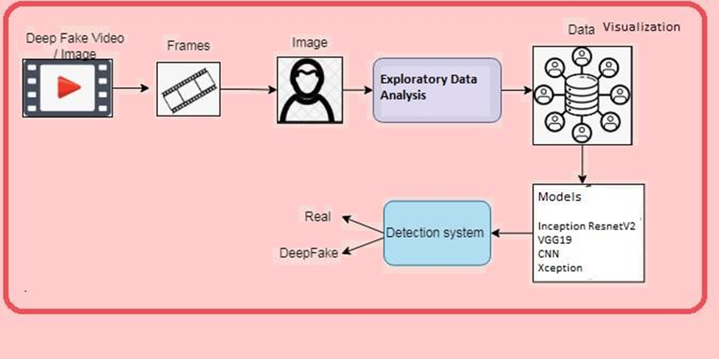
SYSTEM DESIGN
a)System architecture

Slide 14
Data flow diagram

Slide 15
b)UML Diagrams
Unified Modeling Language (UML) diagrams are standardized visual representations used in software engineering to model, design, and document the structure and behavior of systems. They help in visualizing and understanding the components of a system, their relationships, and interactions, ensuring clear communication among developers and stakeholders throughout the software development process.

Slide 16
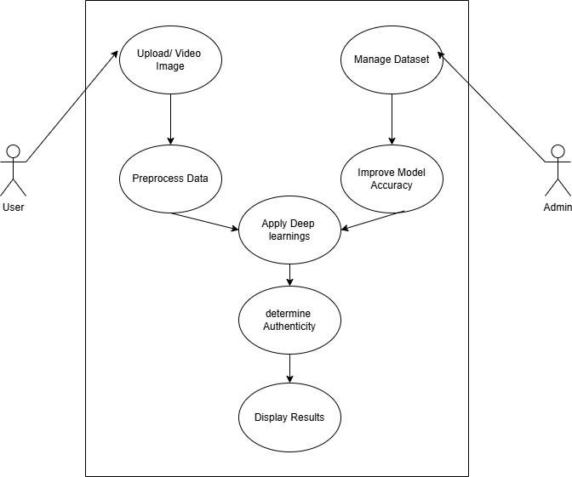
Use case diagram: A use case diagram in the Unified Modelling Language (UML) is a type of behavioural diagram defined by and created from a Use-case analysis. Its purpose is to present a graphical overview of the functionality provided by a system in terms of actors, their goals (represented as use cases), and any dependencies between those use cases.

Slide 17
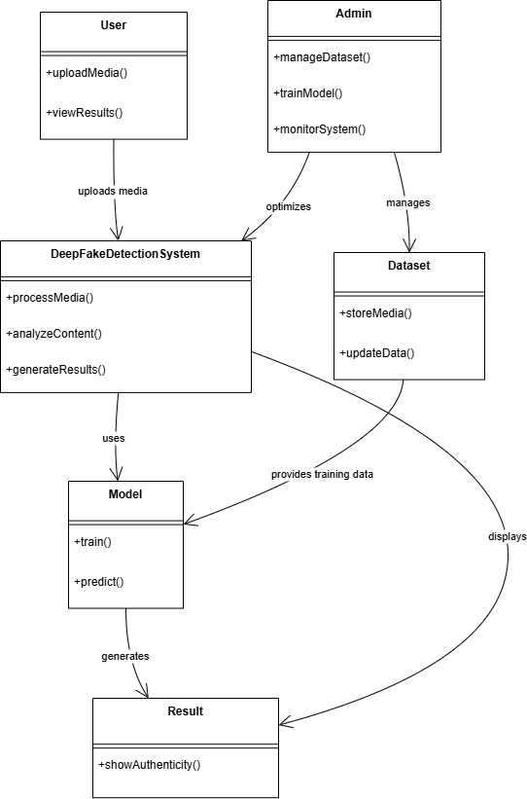
Class diagram: The class diagram is used to refine the use case diagram and define a detailed design of the system. The class diagram classifies the actors defined in the use case diagram into a set of interrelated classes. The relationship or association between the classes can be either an "is-a" or "has-a" relationship.

Slide 18
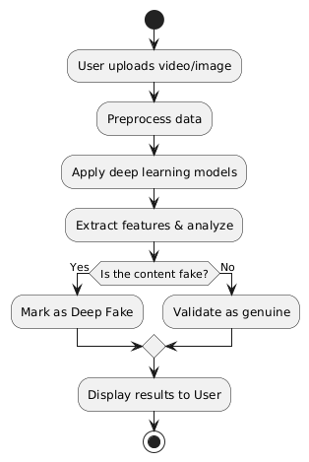
Activity diagram: The process flows in the system are captured in the activity diagram. Similar to a state diagram, an activity diagram also consists of activities, actions, transitions, initial and final states, and guard conditions.

Slide 19
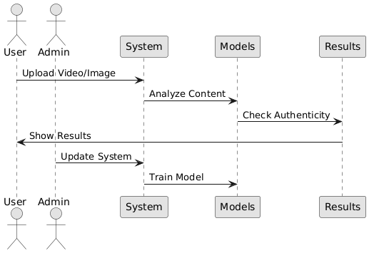
Sequence diagram: A sequence diagram represents the interaction between different objects in the system. The important aspect of a sequence diagram is that it is time-ordered. This means that the exact sequence of the interactions between the objects is represented step by step. Different objects in the sequence diagram interact with each other by passing "messages".

Slide 20
CODE
Code Explanation:
This code imports essential libraries for a deep fake detection project. TensorFlow and Keras are used for loading and processing deep learning models, while dlib and OpenCV assist in face detection and image processing. PIL (Pillow) enables image manipulation, such as enhancement and comparison. Flask is utilized to create a web-based interface for uploading and analyzing images or videos. Additionally, SQLite manages user authentication, and Scikit-learn (Sklearn) provides evaluation metrics like F1-score, recall, and precision for model performance assessment.
Importing Required Libraries
import tensorflow as tf
import dlib
import cv2
import os
import numpy as np
from PIL import Image, ImageChops, ImageEnhance
from tensorflow.keras.models import load_model
from tensorflow.keras.preprocessing.image import img_to_array, load_img
from flask import Flask, render_template, request, redirect, send_file, url_for, Response
from sklearn.metrics import f1_score, recall_score, precision_score
import sqlite3

Slide 21
Initializing Flask Application
app = Flask(__name__)
Setting Upload Folder and Creating It UPLOAD_FOLDER = 'static/uploads' app.config['UPLOAD_FOLDER'] = UPLOAD_FOLDER os.makedirs(UPLOAD_FOLDER, exist_ok=True)
Defining Custom Metrics for Model Evaluation def specificity_m(y_true, y_pred): true_negatives = K.sum(K.round(K.clip((1 - y_true) * (1 - y_pred), 0, 1))) possible_negatives = K.sum(K.round(K.clip(1 - y_true, 0, 1))) specificity = true_negatives / (possible_negatives + K.epsilon()) return specificity def sensitivity_m(y_true, y_pred): true_positives = K.sum(K.round(K.clip(y_true * y_pred, 0, 1))) possible_positives = K.sum(K.round(K.clip(y_true, 0, 1))) sensitivity = true_positives / (possible_positives + K.epsilon()) return sensitivity
Code Explanation
This code initializes a Flask application (app Flask (_name_)) to create a web interface. It sets up an upload folder (static/uploads) to store user-uploaded files and ensures its existence using os.makedirs(). Custom evaluation metrics are defined for model performance, including specificity (measuring true negative rate) and sensitivity (measuring true positive rate). Additionally, MAE (Mean Absolute Error) and MSE (Mean Squared Error) are implemented to evaluate prediction errors. These metrics help assess the accuracy and reliability of the deep learning model.

Slide 22
Loading Deep Learning Models
model_path2 = 'models/cnn.h5'
model_path = 'models/Xception.h5'
custom_objects = {
'f1_score': f1_score,
'recall_m': recall_score,
'precision_m': precision_score,
'specificity_m': specificity_m,
'sensitivity_m': sensitivity_m,
'mae' : mae,
'mse' : mse
}
model = load_model(model_path2, custom_objects=custom_objects)
model1 = load_model(model_path, custom_objects=custom_objects)
Code Explanation
This code loads two deep learning models from pre-trained files stored in the "models" directory. The model_path2 refers to "cnn.h5", which is a Convolutional Neural Network (CNN) model, while model_path refers to "Xception.h5", which is based on the Xception architecture. A dictionary of custom evaluation metrics (like f1_score, recall_m, precision_m, specificity_m, sensitivity_m, mae, and mse) is defined to ensure the models can correctly interpret these functions when loaded. Finally, both models are loaded into memory using load_model(), making them available for inference.

Slide 23
Flask Routes(Web pages)
Basic Page rendering
@app.route("/index")
def index():
return render_template("index.html")
@app.route("/index1")
def index1():
return render_template("index1.html")
@app.route("/index2")
def index2():
return render_template("index2.html")
@app.route('/')
@app.route('/home')
def home():
return render_template('home.html')
Code Explanation
This code defines Flask routes for rendering different web pages in a web application.
1. The @app.route("/index") function loads the "index.html" page when a user visits /index.
2. Similarly, /index1 and /index2 load "index1.html" and "index2.html", respectively.
3. The / and /home routes both serve "home.html", making it the default homepage of the application.
4. The render_template() function is used to render HTML files from the templates directory in Flask.

Slide 24
@app.route('/detection_results')
def detection_results():
return render_template('detection_results.html')
@app.route('/upload')
def upload():
return render_template('upload.html')
@app.route('/logon')
def logon():
return render_template('signup.html')
@app.route('/login')
def login():
return render_template('signin.html')
@app.route('/note')
def note():
return render_template('note.html')
Code Explanation
This Flask code defines multiple routes for rendering different web pages. The /detection_results route loads "detection_results.html", which likely displays results from an image or data processing task. The /upload route renders "upload.html", allowing users to upload files. The /logon route serves "signup.html", facilitating user registration, while the /login route loads "signin.html" for authentication. Lastly, the /note route displays "note.html", which may allow users to create or view notes. Each function uses render_template(), meaning the corresponding HTML files should be placed inside the templates directory.

Slide 25
User Authentication (signin&signup)
@app.route("/signup")
def signup():
username = request.args.get('user','')
name = request.args.get('name','')
email = request.args.get('email','')
number = request.args.get('mobile','')
password = request.args.get('password','')
con = sqlite3.connect('signup.db')
cur = con.cursor()
cur.execute("insert into `info` (`user`,`email`, `password`,`mobile`,`name`) VALUES (?,
?, ?, ?, ?)",(username,email,password,number,name))
con.commit()
con.close()
return render_template("signin.html")
Code Explanation
This Flask route handles user signup by capturing form data from the request and storing it in an SQLite database. When a user accesses the /signup route, the function retrieves the values of user, name, email, mobile, and password from the URL parameters using request.args.get(). It then establishes a connection to an SQLite database named signup.db and inserts the collected data into a table called info. After committing the changes and closing the database connection, the function renders "signin.html", redirecting the user to the login page after successful registration.

Slide 26
Signin Route
@app.route("/signin")
def signin():
mail1 = request.args.get('user','')
password1 = request.args.get('password','')
con = sqlite3.connect('signup.db')
cur = con.cursor()
cur.execute("select `user`, `password` from info where `user` = ? AND `password` = ?",(mail1,password1,))
data = cur.fetchone()
if data == None:
return render_template("signin.html")
elif mail1 == 'admin' and password1 == 'admin':
return render_template("index1.html")
elif mail1 == str(data[0]) and password1 == str(data[1]):
return render_template("index1.html")
else:
return render_template("signup.html")
Code Explanation
This Flask route handles user sign-in by verifying credentials from an SQLite database. It retrieves the username and password from the request and checks if they match an entry in the info table. If the credentials belong to an admin or a valid user, it redirects to index1.html; otherwise, it sends the user back to the sign-in or sign-up page. The current implementation stores passwords in plain text, which is a security risk. Using password hashing (like bcrypt) is recommended for better security.

Slide 27
Image Classification
@app.route("/predict", methods=["GET", "POST"])
def predict_img():
if request.method == "POST":
if 'file' in request.files:
f = request.files['file']
filename = f.filename
file_path = os.path.join(app.config['UPLOAD_FOLDER'], filename)
f.save(file_path)
image = load_img(file_path, target_size=(128,128))
image = img_to_array(image) / 255.0
image = np.expand_dims(image, axis=0)
result = np.argmax(model1.predict(image))
ans = 'Fake' if result == 0 else 'Real'
return render_template('display_image.html', result=ans)
return render_template('index.html')
Code Explanation
This Flask route handles image prediction for fake or real classification. When a user uploads an image via a POST request, the file is saved to a configured upload folder. The image is then resized to 128x128 pixels, converted to an array, normalized, and expanded to match the model's input shape. The pre-trained model1 predicts the class, and the highest probability index determines whether the image is labeled as "Fake" or "Real." The result is displayed on display_image.html. Let me know if you need improvements or additional security measures!

Slide 28
Video Classification
@app.route("/predict1", methods=["GET", "POST"])
def predict_video():
if request.method == "POST":
if 'file' in request.files:
f = request.files['file']
filename = f.filename
file_path = os.path.join(app.config['UPLOAD_FOLDER'], filename)
f.save(file_path)
cap = cv2.VideoCapture(file_path)
frames = []
while True:
ret, frame = cap.read()
if not ret:
break
frame = cv2.resize(frame, (128, 128))
frames.append(frame)
cap.release()
video_data = np.array(frames) / 255.0
predictions = model.predict(video_data)
result = np.argmax(predictions, axis=1)
ans = 'Fake' if np.sum(result == 0) > np.sum(result == 1) else 'Real'
return render_template('display_image.html', result=ans)
return render_template('index.html')
Code Explanation
The /predict1 Flask route handles video file uploads and deepfake detection. When a POST request is made with a video file, the file is saved to the server. The video is then read frame by frame using OpenCV, resized to (128, 128), and stored in a list. These frames are converted into a NumPy array and normalized by dividing pixel values by 255. The pre-trained model then processes these frames and predicts whether they are "Fake" or "Real." The classification is based on majority voting-if most frames are predicted as "Fake," the final result is "Fake"; otherwise, it's "Real." The result is then displayed on the display_image.html page.

Slide 29
EXCEPTION ALGORITHM
def recall_m(y_true, y_pred):
true_positives = K.sum(K.round(K.clip(y_true * y_pred, 0, 1)))
possible_positives = K.sum(K.round(K.clip(y_true, 0, 1)))
recall = true_positives / (possible_positives + K.epsilon())
return recall
def precision_m(y_true, y_pred):
true_positives = K.sum(K.round(K.clip(y_true * y_pred, 0, 1)))
predicted_positives = K.sum(K.round(K.clip(y_pred, 0, 1)))
precision = true_positives / (predicted_positives + K.epsilon())
return precision
def f1_score(y_true, y_pred):
precision = precision_m(y_true, y_pred)
recall = recall_m(y_true, y_pred)
return 2*((precision*recall)/(precision+recall+K.epsilon()))
def specificity_m(y_true, y_pred):
true_negatives = K.sum(K.round(K.clip((1 - y_true) * (1 - y_pred), 0, 1)))
possible_negatives = K.sum(K.round(K.clip(1 - y_true, 0, 1)))
specificity = true_negatives / (possible_negatives + K.epsilon())
return specificity
def sensitivity_m(y_true, y_pred):
true_positives = K.sum(K.round(K.clip(y_true * y_pred, 0, 1)))
possible_positives = K.sum(K.round(K.clip(y_true, 0, 1)))
sensitivity = true_positives / (possible_positives + K.epsilon())
return sensitivity
def mae(y_true, y_pred):
return K.mean(K.abs(y_true - y_pred))
def mse(y_true, y_pred):
return K.mean(K.square(y_true - y_pred))
ALGORITHM
Xception: Xception is a convolutional neural network that is 71 layers deep. You can load a pretrained version of the network trained on more than a million images from the ImageNet database. The pretrained network can classify images into 1000 object categories, such as keyboard, mouse, pencil, and many animals.

Slide 30
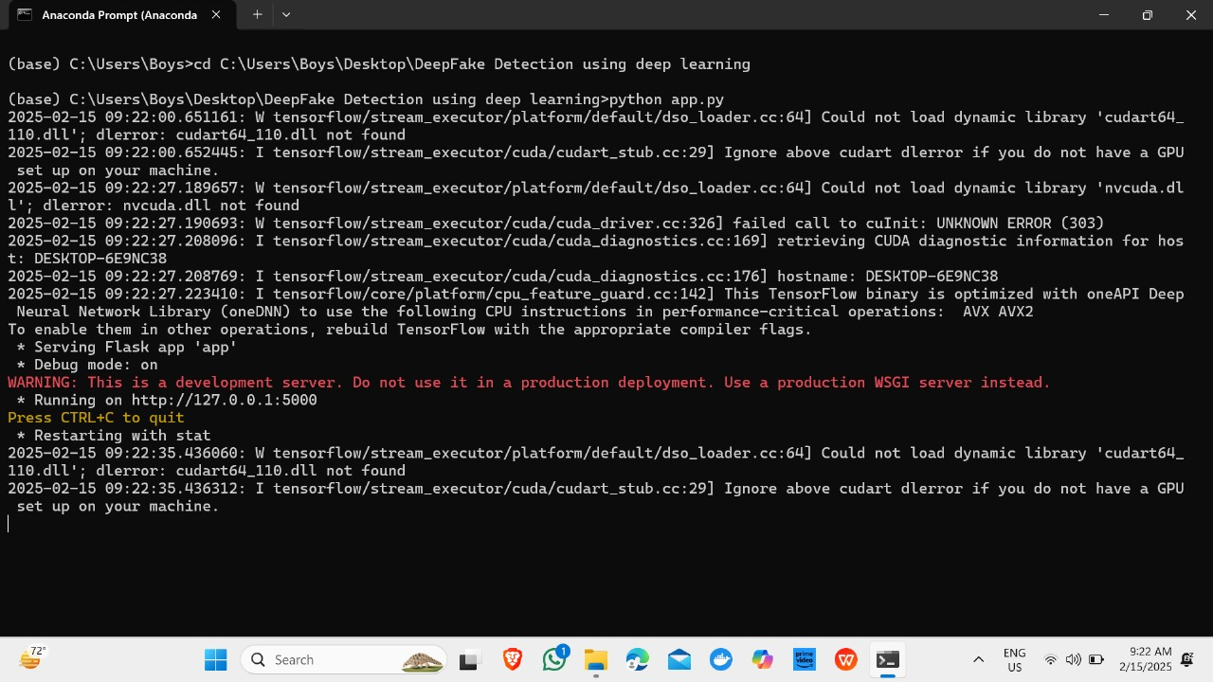
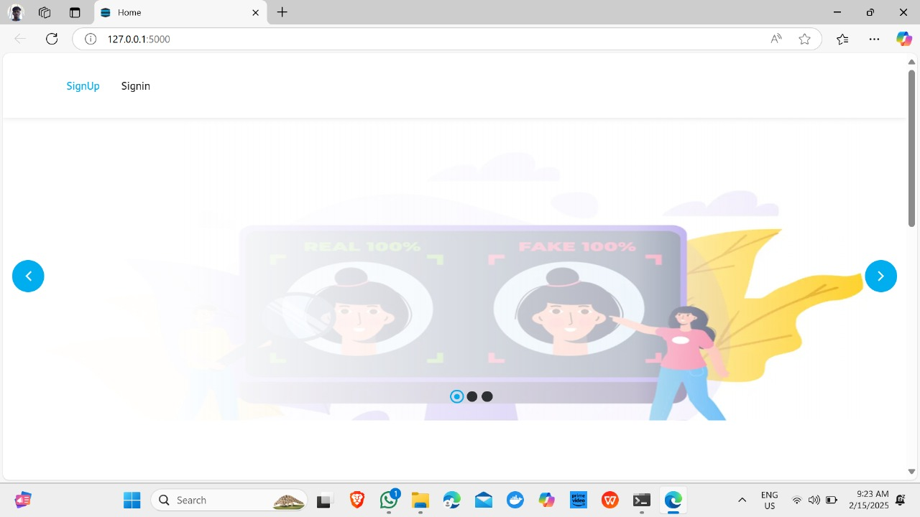
OUTPUT:
STEP-1
STEP-2

Slide 31
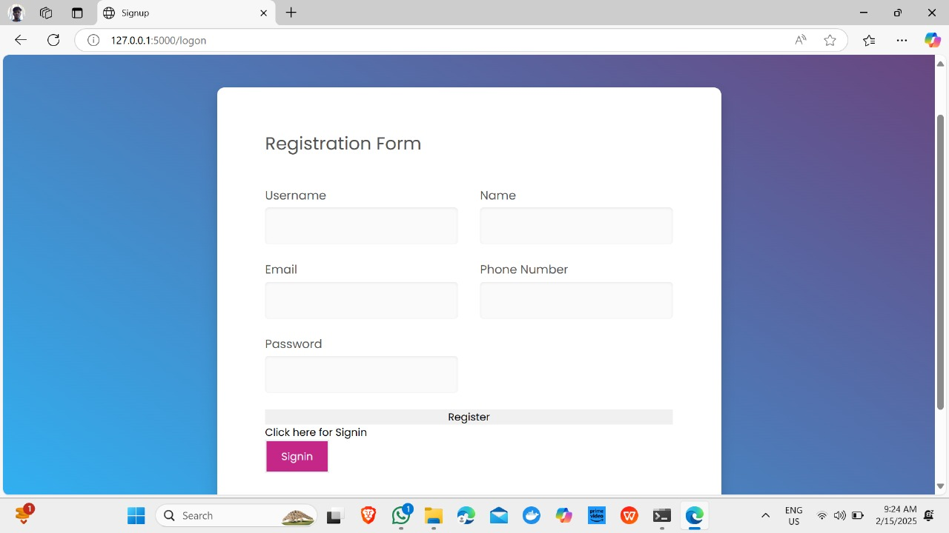
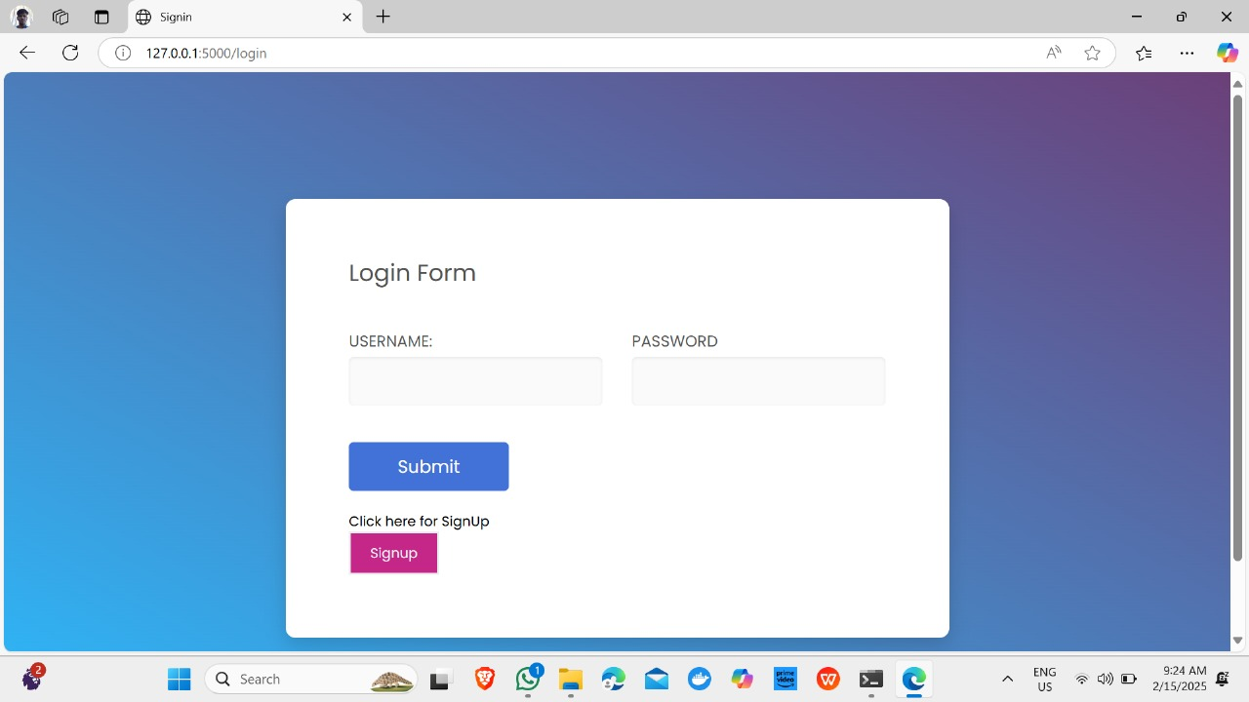
STEP-4
STEP-3

Slide 32
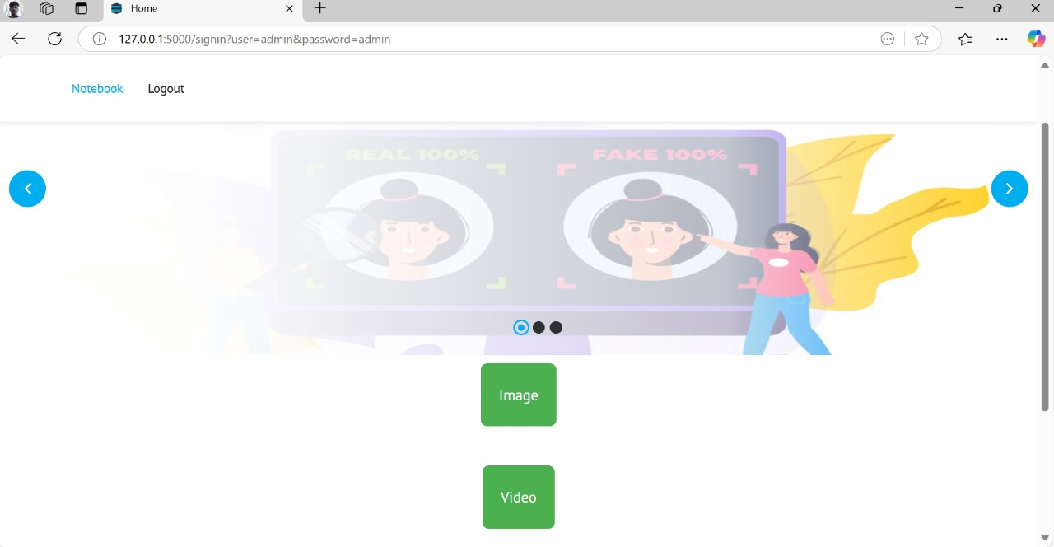
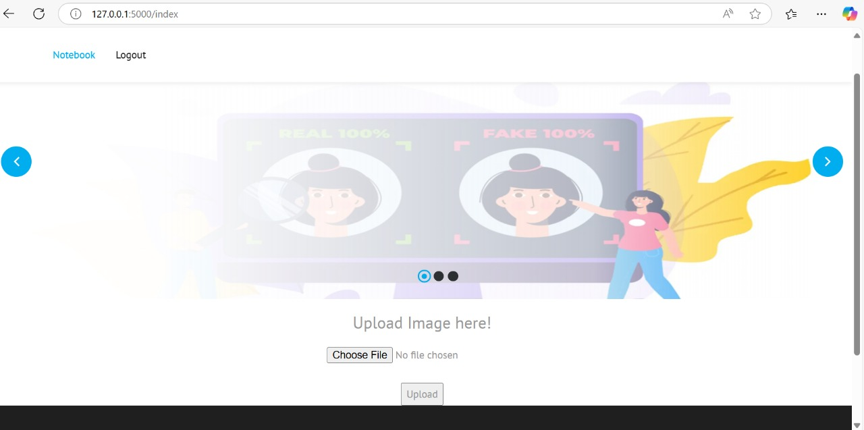
STEP-5
STEP-6

Slide 33
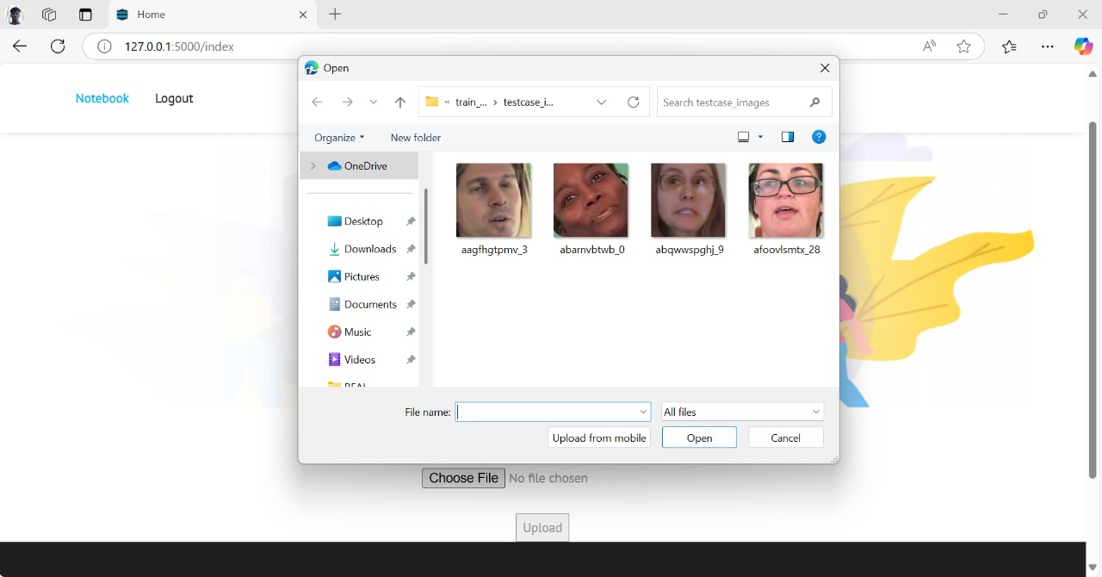
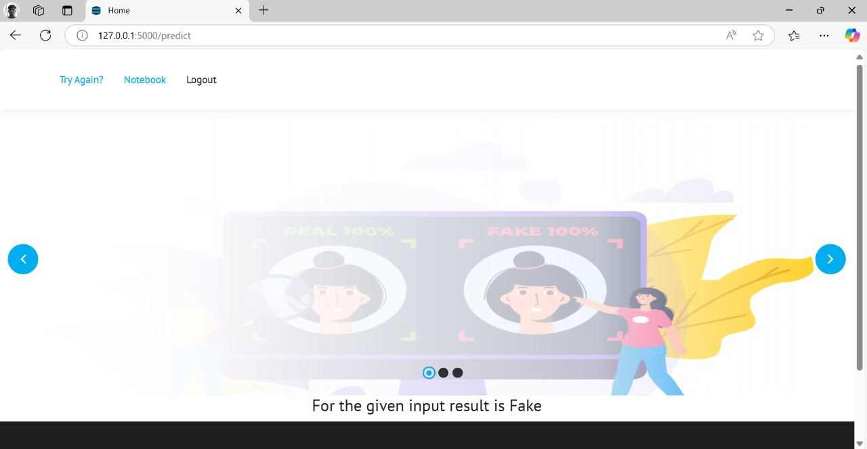
STEP-7
STEP-8

Slide 34
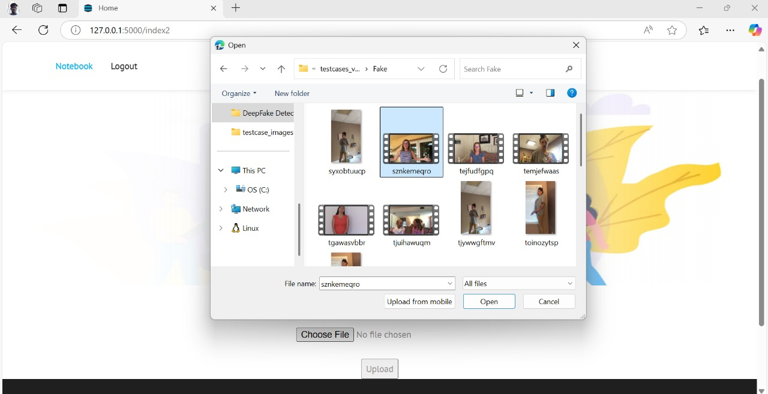
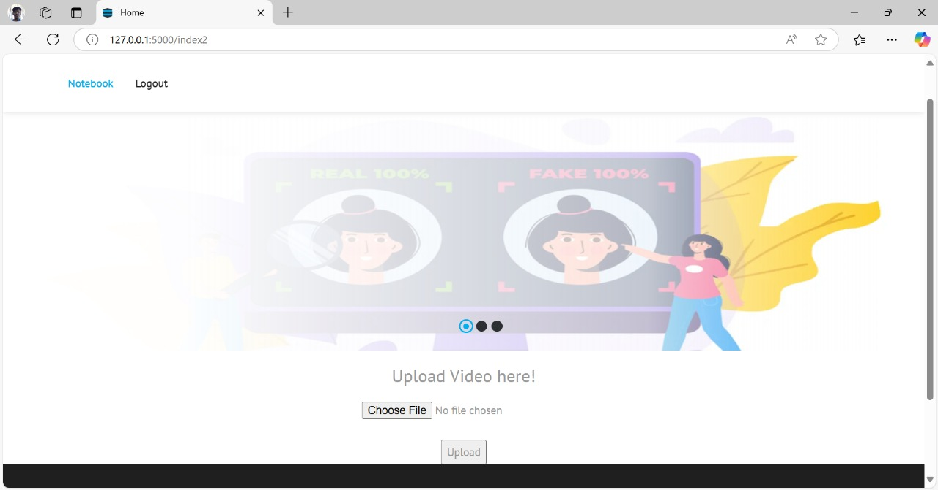
STEP-9
STEP-10

Slide 35

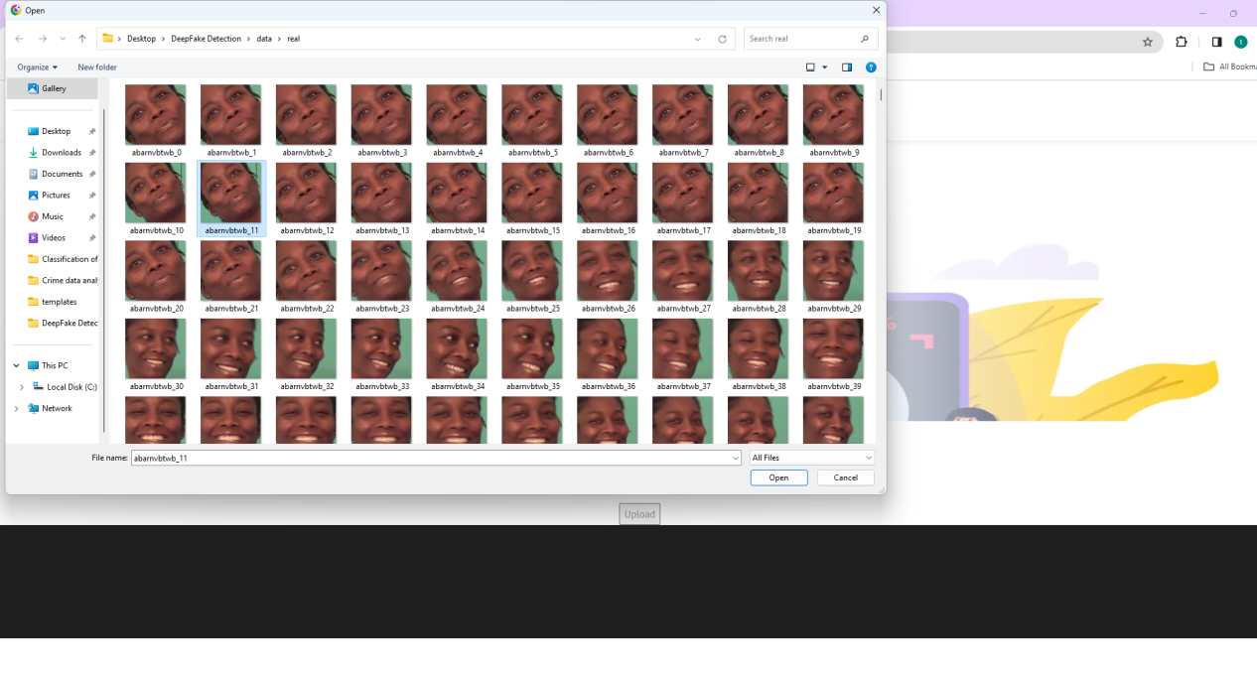
STEP-11
STEP-12

Slide 36
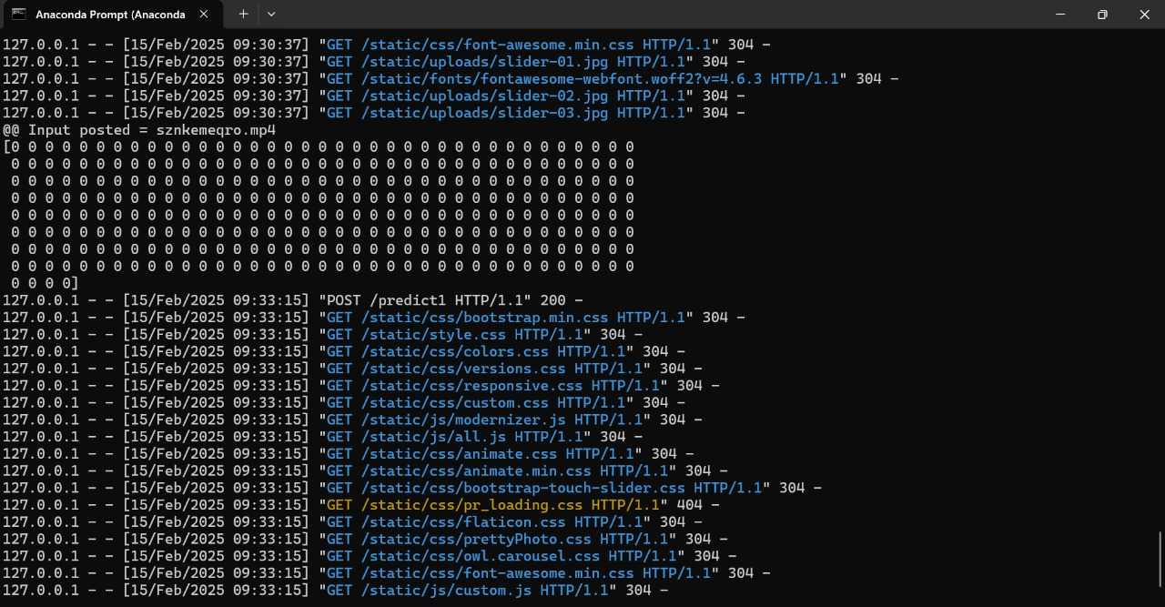
PREDECTION OF FAKE IMAGES OR VIDEOS

Slide 37
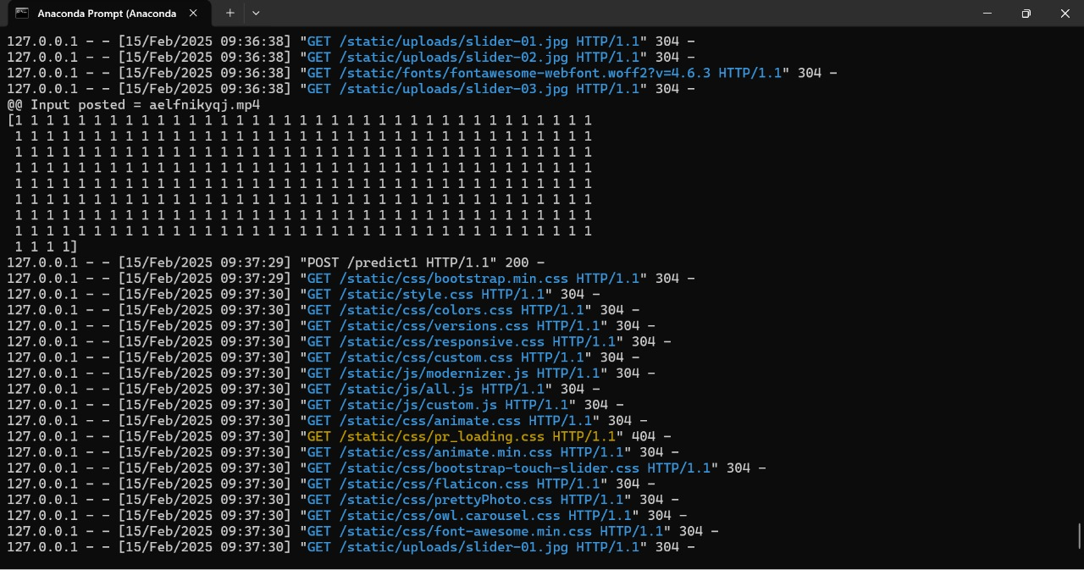
PREDECTION OF REAL IMAGES OR VIDEOS

Slide 38
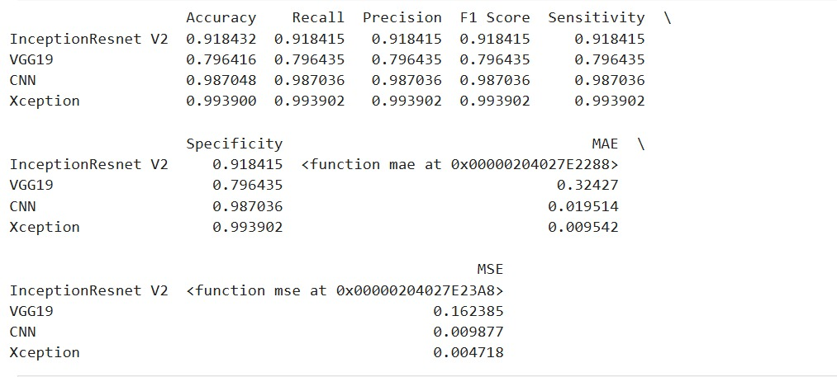
COMPARISON OF ALGORITHMS

Slide 39
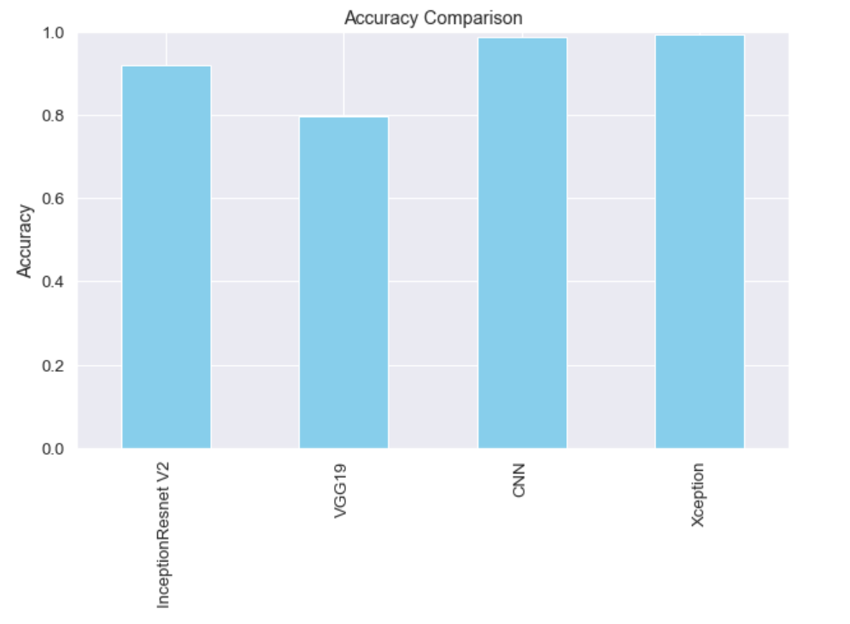

Slide 40
THANK YOU

